Slide 1
HEART DISEASE DATASET
Presented By
Name : SATHIK S
College name : Jayaraj annapackiam CSI college of engineering
Department : Mechanical engineering

Slide 2
OUTLINE
Problem Statement
Proposed System/Solution
System Development Approach
Algorithm & Deployment
Result
Conclusion
Future Scope
References

Slide 3
Problem Statement
“Despite advancements in medical technology and increased awareness, heart disease remains the leading cause of death globally. Factors such as lifestyle choices, genetics, and socioeconomic status contribute to its prevalence. There’s a pressing need for innovative interventions, personalized treatments, and improved public health strategies to reduce the burden of heart disease and enhance patient outcomes.”

Slide 4
Proposed Solution
Prevention through education: Implementing comprehensive public health campaigns to raise awareness about risk factors, healthy lifestyle choices, and early detection measures. Lifestyle interventions: Promoting healthy habits such as regular exercise, balanced diet, smoking cessation, and stress management to reduce the incidence of modifiable risk factors like obesity, high cholesterol, and hypertension.
Early detection and diagnosis: Increasing access to screening programs and diagnostic tools such as blood tests, electrocardiograms (ECG), and imaging techniques to identify heart disease in its early stages when interventions are most effective. Personalized treatment plans: Utilizing advances in genetic testing, biomarkers, and precision medicine to tailor treatment strategies to individual patients, optimizing efficacy and minimizing side effects.
Innovative therapies: Investing in research and development of novel medications, medical devices, and procedures to improve outcomes for patients with various types of heart disease, including coronary artery disease, arrhythmias, and heart failure. Accessible healthcare: Ensuring equitable access to high-quality cardiovascular care for all populations, regardless of geographic location or socioeconomic status, through healthcare system reforms and community outreach programs.
By combining these approaches, we can work towards reducing the incidence, morbidity, and mortality associated with heart disease, ultimately improving the overall cardiovascular health of populations worldwide.

Slide 5
System Approach
A systemic approach to addressing heart disease involves considering the interconnected factors that contribute to its development, progression, and management. Here’s an overview of a systemic approach:
Biological factors: Understanding the physiological mechanisms underlying heart disease, including genetics, hormonal imbalances, inflammation, and metabolic abnormalities. Behavioral factors: Recognizing the impact of lifestyle choices such as diet, exercise, smoking, and stress on cardiovascular health. Implementing interventions to promote healthy behaviors and mitigate risk factors
Environmental factors: Identifying environmental influences such as air pollution, socioeconomic conditions, access to healthcare, and built environments that may affect cardiovascular health. Implementing policies and initiatives to create healthier environments and reduce disparities. Healthcare system: Evaluating the healthcare infrastructure, including access to preventive services, diagnostic tools, treatment options, and specialized care for heart disease. Implementing strategies to improve access, affordability, and quality of care for all individuals.
Data and technology: Leveraging data analytics, artificial intelligence, and digital health tools to enhance risk prediction, early detection, personalized treatment approaches, and patient monitoring. Integrating technological solutions into healthcare delivery systems to optimize outcomes and efficiency. Community engagement: Engaging communities in health promotion efforts, raising awareness, providing education, and fostering support networks for individuals affected by heart disease. Empowering communities to advocate for policies and resources that promote cardiovascular health and address social determinants of health.
By taking a systemic approach that addresses biological, behavioral, environmental, healthcare system, data and technology, and community factors, we can develop comprehensive strategies to prevent, diagnose, and manage heart disease effectively while promoting overall cardiovascular health and well-being.

Slide 6
Algorithm & Deployment
Developing an algorithm for heart disease prediction involves collecting relevant medical data, choosing appropriate features, and selecting a suitable machine learning model like logistic regression or random forest. Once trained, the model needs to be deployed, which could involve creating a web application, API, or integrating it into existing healthcare systems. Deployment also requires careful consideration of data privacy, security, and regulatory compliance.

Slide 7
Deployment
To deploy a heart disease prediction model, you'll first need to choose a deployment platform, such as a cloud service provider like AWS, Azure, or Google Cloud. Next, you'll containerize your model using tools like Docker and Kubernetes for easy deployment and scalability. Finally, you can create an API endpoint to allow external applications to interact with your model for prediction purposes. Don't forget to ensure data privacy and security measures are in place throughout the deployment process.

Slide 8

Result

Slide 9


Slide 10


Slide 11
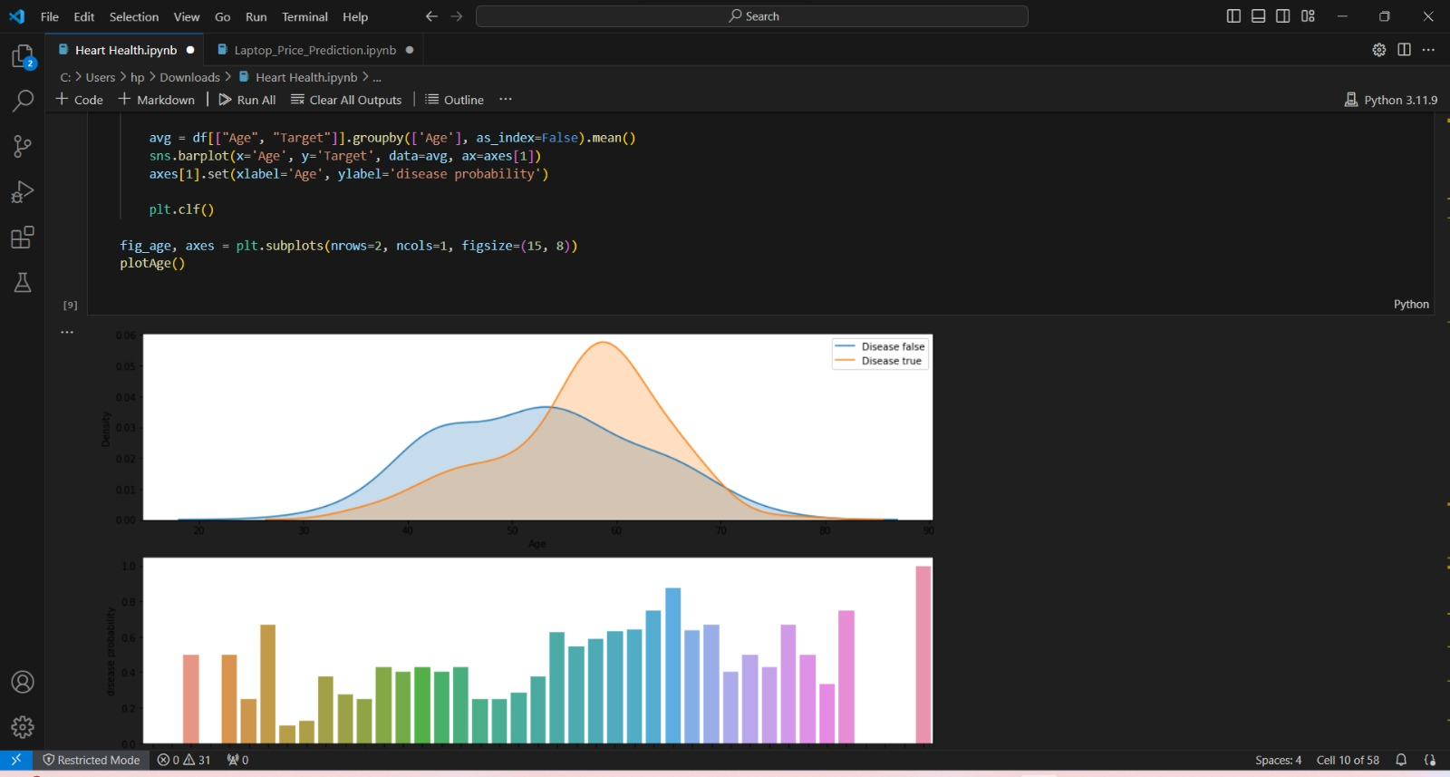

Slide 12


Slide 13


Slide 14


Slide 15


Slide 16


Slide 17


Slide 18
Conclusion
Heart disease is a serious health concern worldwide, but with proper lifestyle changes, medical interventions, and ongoing research, there’s hope for prevention and treatment. It’s crucial to prioritize heart health through regular exercise, a balanced diet, managing stress, and avoiding smoking and excessive alcohol consumption. Additionally, early detection through regular check-ups and screenings can significantly improve outcomes. Together, we can work towards reducing the burden of heart disease and promoting cardiovascular wellness for everyone.

Slide 19
Future scope
In the future, advancements in medical technology, personalized medicine, and preventive strategies offer promising avenues for managing heart disease. Innovations such as wearable devices for continuous monitoring, genetic testing for risk assessment, and targeted therapies based on individual characteristics could revolutionize treatment approaches. Additionally, artificial intelligence and machine learning algorithms may play a crucial role in predicting heart disease risk more accurately and developing personalized treatment plans. Collaborative efforts between healthcare providers, researchers, and technology companies will continue to drive progress in combating heart disease and improving patient outcomes.

Slide 20
References
Sure, here’s a reference for further reading on heart disease: American Heart Association. (n.d.). Heart Disease and Stroke Statistics—2021 Update: A Report From the American Heart Association. Circulation, 143(8), e254-e743. doi:10.1161/CIR.0000000000000950 This report provides comprehensive statistics and information on heart disease and stroke, including prevalence, risk factors, and treatment options.

Slide 21
THANK YOU

